Slide 1
Extending LANs: Fiber Modems, Repeaters, Bridges, and Switches

Slide 2
Introduction
LAN provides services from the link layer
Node-to-node communication
Framing: each frame has physical address
Link access: MAC protocol handles transport over the link
Reliable delivery: normally not provided
Flow control: limited at data link layer
Error detection/ correction
Half-duplex/ full duplex

Slide 3
Introduction cont’
LAN technologies are designed with constraints of speed, distance and costs
Typical LAN technology can span, at most, a few hundred meters
Factors considered when designing a network technology:
Capacity
Max delay
distance

Slide 4
LAN design for distance
Many LANs use shared medium
Length of medium affects fair, shared access to medium
CSMA/CD - delay between frames, minimum frame length
Length of medium affects strength of electrical signals and noise immunity

Slide 5
LAN extensions
Several techniques extend diameter of LAN medium
Most techniques use additional hardware
LAN signals relayed between LAN segments
Resulting mixed technology stays within original engineering constraints while spanning greater distance

Slide 6
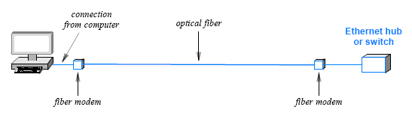
Fiber optic extensions
The simplest LAN extension mechanism:
an optical fiber and a pair of fiber modems
connect a computer to a remote Ethernet

Slide 7
Fiber optic extensions cont’
Fiber modems:
accept packets over the Ethernet interface and send them over the optical fiber
accept packets that arrive over the optical fiber and send them over the Ethernet interface
Typically connect two LANs in different buildings through a bridge

Slide 8
Connecting Devices
Connecting
Devices
Networking
Devices
Internetworking
Devices
Repeaters
(physical)
Bridges
(Data Link)
Routers
(Network)
Gateways
(Network and above)

Slide 9
Repeaters
A repeater:
an analog device used to propagate LAN signals over long distances
does not understand packets or signal coding
amplifies the signal received
Infrared transmitted
to Cable box
((((((
Remote
sensor
Cable box
repeater

Slide 10
Bridges
Connect two LAN segments
Retransmit frames from one segment on other segment(s)
Handle complete frame
Recognize not only the signal but also the address of each frame
Perform some processing on frames
Invisible to other attached computers

Slide 11
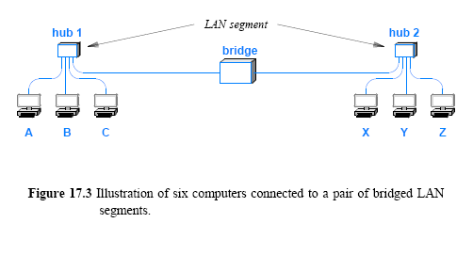
Bridged LAN segments
Relatively easy to use - just plug in
Isolate collisions, noise

Slide 12
Filtering bridges
Bridges can do additional processing
Don't forward collisions, noise
Only forward frames where necessary
frame filtering
Uses MAC addresses to perform filtering
Learns location of stations by watching frames
Forwards all broadcast and multicast packets

Slide 13
Frame filtering
Bridge checks destination of each incoming frame
Looks up destination in list of known stations
Forwards frame to next interface on path to destination
Doesn't forward frame if destination on LAN segment from which frame was received

Slide 14
How does bridge set up table?
Bridge examines source address in each frame
Adds entry to list for LAN segment from which frame was received
Must forward any frame whose destination is not in the list on every interface

Slide 15
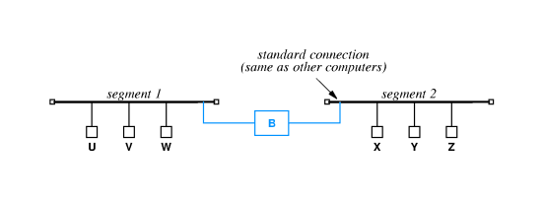
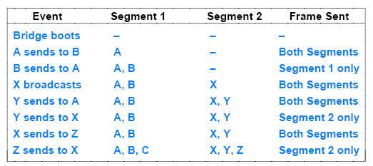
Filtering example

Slide 16
Startup behavior of filtering bridges
Initially, the forwarding tables in all bridges are empty
First frame from each station on LAN is forwarded to all LAN segments
After all stations have been identified, frames are only forwarded as needed
May result in burst of traffic after, e.g., power failure

Slide 17
Designing with filtering bridges
Filtering bridge allows concurrent use of different LAN segments if traffic is local
U and V can exchange frames at the same time X and Y exchange frames
Designers identify patterns of local communication and isolate groups of communicating computers with bridges

Slide 18
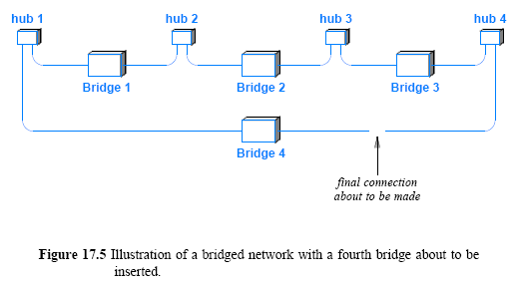
Bridges and cycles
Four LAN segments currently connected by three bridges and a fourth bridge about to be inserted

Slide 19
Bridges and cycles cont’
the fourth bridge
creates a loop
The loop forwards broadcasts indefinitely
Creates broadcast flooding
Distributed Spanning Tree (DST)
Create a tree to prevent a cycle

Slide 20
Distributed Spanning Tree
Initially (DEC in 1985) designed for Ethernet networks
Spanning Tree Protocol (STP)
STP consists of three steps:
Root election
Shortest path computation
Forwarding
Ethernet bridges communicate amongst themselves using a multicast address that is reserved for STP

Slide 21
Distributed Spanning Tree
IEEE created a standard named 802.1d (in 1990)
IEEE standard 802.1q
provides a way to run STP on a set of logically independent networks
share a physical medium
Cisco created Per-VLAN Spanning Tree (PVST) for use on a VLAN switch
IEEE standard 802.1w introduced the Rapid STP (RSTP) has been incorporated in 801.1d-2004 (in 1998), and now replaces STP, some versions are
Multiple Instance STP (MISTP)
Multiple STP (MSTP)

Slide 22
Switching and Layer 2 Switches
An Ethernet switch (a Layer 2 switch)
a switch provides multiple ports
a switch allows computers to send frames to one another
The difference between a hub and a switch:
a hub operates as an analog device that forwards signals among computers
a switch is a digital device that forwards packets
a hub as simulating a shared transmission medium
a switch as simulating a bridged network

Slide 23
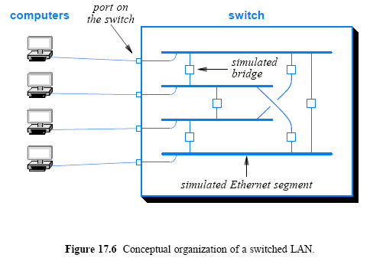

Slide 24
Switches and hubs
A switch consists of an intelligent interface attached to each port
a central fabric that provides simultaneous transfers
An interface contains
A processor, memory, and other hardware needed to accept a packet
A forwarding table
An interface can buffer arriving packets when an output port is busy
Advantage of using a switched LAN
a hub can only support one transmission at a time
a switch permits multiple transfers to occur at the same time, provided the transfers are independent

Slide 25
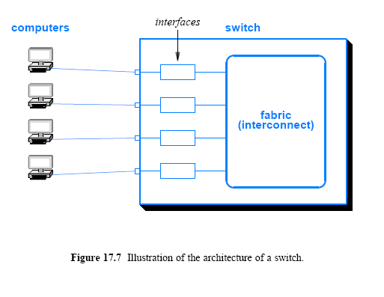

Slide 26
Switched Ethernet
Contention moved from bus to “single point”
Ethernet switch emulates CSMA/CD
Upon buffer overflow => collision signal
Medium-haul GigE/10GigE (802.3ae): 500m, 5km, 40km
Disable CSMA/CD
Purely point-to-point link
QoS: IEEE 802.3p
Today’s Ethernet: switch, CSMA/CD, short- and long-distance LAN -> a result of incremental legacy-respecting changes

Slide 27
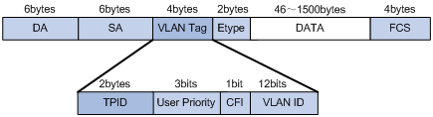
VLAN Switches
Allows a manager to configure a single switch to emulate multiple, independent switches using VLAN tag (defined as 802.1Q by IEEE)
A set of ports on the switch can be specified as virtual LAN 1 and so on
When a computer on virtual LAN 2 broadcasts a packet
only those computers on the virtual LAN 2 receive a copy
An Ethernet frame with an 802.1Q VLAN tag

Slide 28
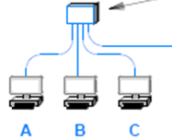
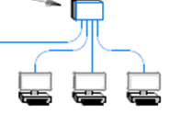
VLAN Switches
It is important to guarantee that a set of computers can communicate
For example, a company may choose to provide a firewall between computers in the CEO's office and other computers in the company
E.g. computers A, C, F can be assigned as VLAN 1
VLAN
switch 1
VLAN
switch 2
802.1Q format used
Regular Ethernet frames are used
D E F

